Slide 1
Simulating Slime Mold through a Random Walk with a Chemoattractant
Justin Couvrette, Jesse Reyes, and Ali Mohammad
Spring 2023
BioE 230

Slide 2
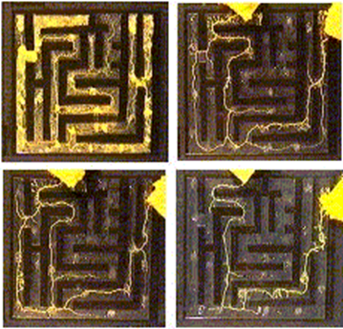
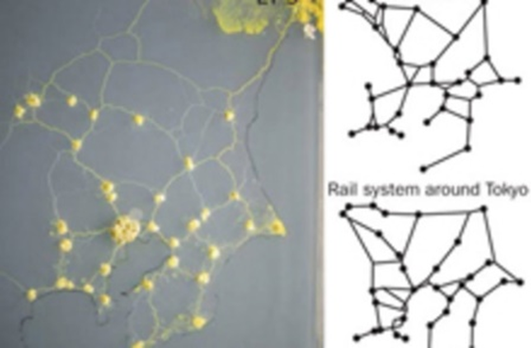
Background
Nakagaki, T., Yamada, H. & Tóth, Á. Maze-solving by an amoeboid organism. Nature 2000, 407, 470..
Tero, et al., Rules for Biologically Inspired Adaptive Network Design. Science 2010, 327, 5964, 439-442.

Slide 3
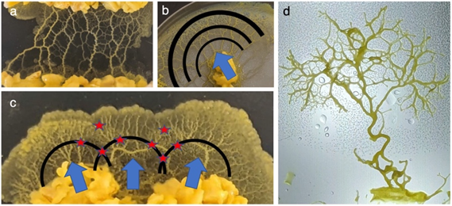
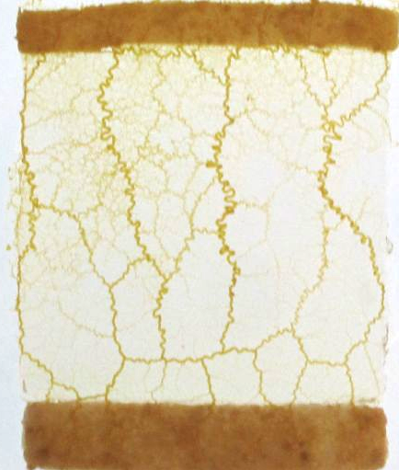
How the Slime Grows
This slime mold ventures from its starting location in search of food
Chemotaxis: when a cell moves in a specific direction when a chemical gradient is present
In our system the mold grows from a narrow rectangle of colonized oat towards a narrow rectangle of uncolonized oat, forming a network along the way

Slide 4
Objectives for project:
Add chemoattractant force to ABP model to simulate slime mold moving toward nutrient point
Use line of nutrient as chemoattractant for slime mold to generate 2D patterns for materials
Repeat with different line shapes
Quantification and comparison to experimentation

Slide 5
ABP model for completely random walker
Pseudo-code:
Randomize initial position of walkers along x-axis
For each walker:
Calculate random walk vector using ABP model
Add change to previous position and record new position
Take next step until n steps are complete
Move onto next walker for m walkers
Model:
ABP vector:
Notes:
Parameters used for this: vel =5.0; dt = 1; Drot = 0.1; Dtrans = 0.1; nutrient_conc = 10^6, start_conc = 10^2

Slide 6
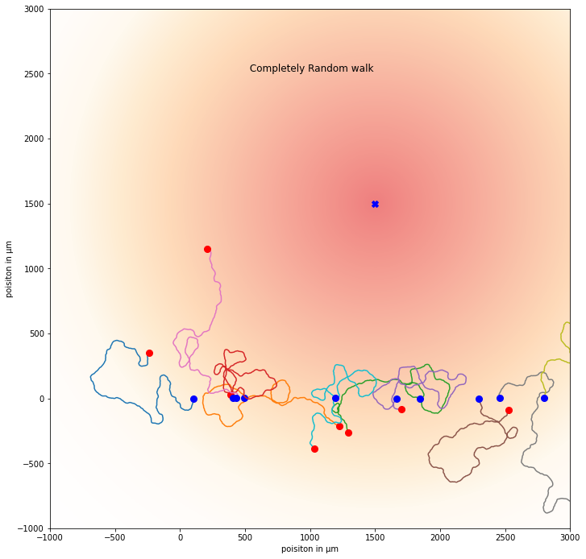
Results - Random Walker using ABP model
Notes:
Parameters used for this: vel =5.0; dt = 1; Drot = 0.1; Dtrans = 0.1; nutrient_conc = 10^6, start_conc = 10^2
If asked why we used the distance scales we used, we can say the nature paper we used as inspiration grows their slime mold ~3 cm from the nutrient

Slide 7
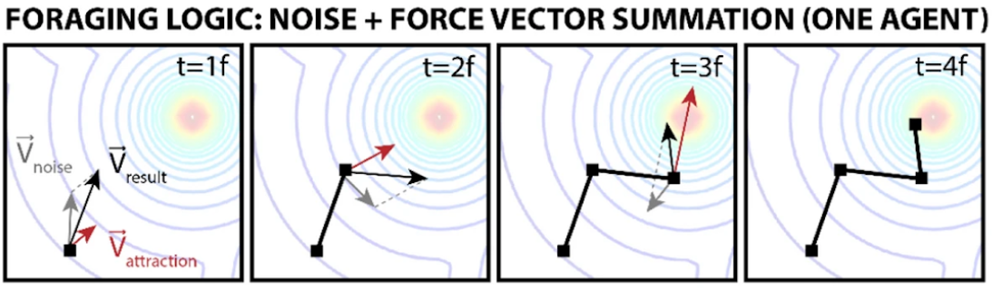
Objective 1: Add chemoattractant vector to ABP model to simulate slime mold moving toward nutrient point
Kay, R., Mattacchione, A., Katrycz, C. et al. Stepwise slime mould growth as a template for urban design. Sci Rep 12, 1322 (2022). https://doi.org/10.1038/s41598-022-05439-w

Slide 8
Model for random walker with nutrient point as chemoattractant
Pseudo-code:
Randomize initial position of walkers along x-axis
For each walker:
Calculate attractant vector at current position
Calculate random walk vector using ABP model
Combine vectors for random walk and attractant for change in position
Add change to previous position and record new position
Repeat until n steps are complete
Move onto next walker for m walkers
Model:
ABP vector:
Chemoattractant vector:
Notes:
Parameters used for this: vel =5.0; dt = 1; Drot = 0.1; Dtrans = 0.1; nutrient_conc = 10^6, start_conc = 10^2

Slide 9
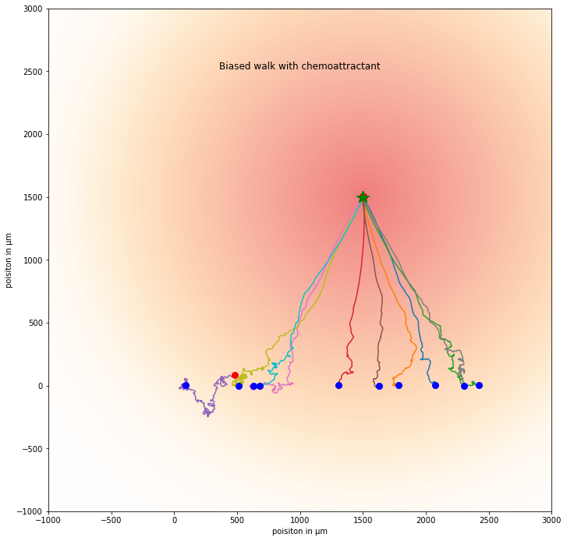
Results - Random walkers using chemoattractant point
Notes:
Parameters used for this: vel =5.0; dt = 1; Drot = 0.1; Dtrans = 0.1; nutrient_conc = 10^6, start_conc = 10^2
Completely Random Walk image entails the random 2D ABP movement with very few walkers reaching optimal level of attraction towards the nutrient center.
Biased walk with the chemo attractant presents the linear movement from gradient x to location of the nutrient center in the y axis with progression correlating to strength of attractive forces of the attractant.
Biased walk with chemo attractant is “ strict “ and normalizes each point to origin/border and then overlaps but moves in a relatively linear fashion toward the nutrient center.

Slide 10
Objective 2: Use line of nutrient as chemoattractant for slime mold to generate 2D patterns for materials
Constant chemoattractant force

Slide 11
Model for random walker with nutrient line as chemoattractant
Pseudo-code:
Randomize initial position of walkers along x-axis
For each walker:
Calculate attractant vector at current position
Calculate random walk vector using ABP model
Combine vectors for random walk and attractant for change in position
Add change to previous position and record new position
Repeat until n steps are complete
Move onto next walker for m walkers
Model:
ABP vector:
Chemoattractant vector:
Notes:
Parameters used for this: vel =10.0; dt = 1; Drot = 0.05; Dtrans = 5; nutrient_conc = 10^5, start_conc = 10^3

Slide 12
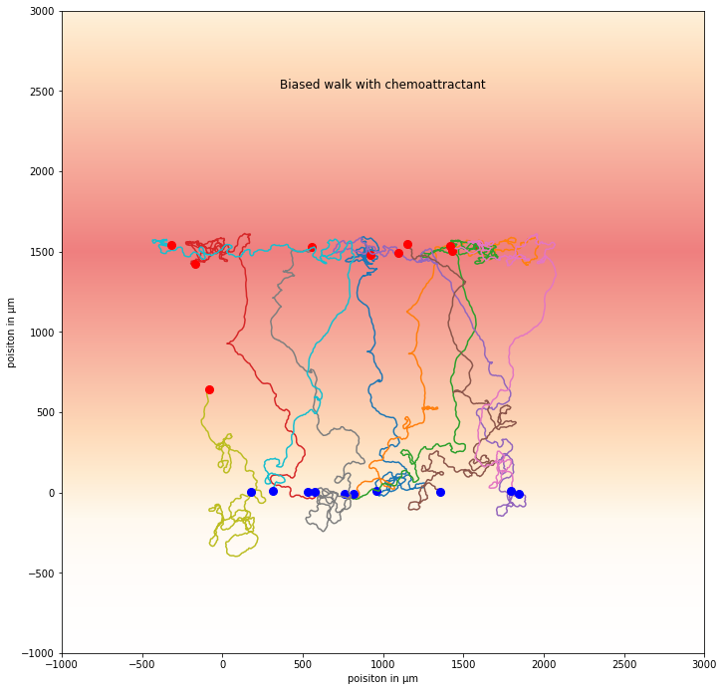
Results - Random walkers using chemoattractant line
Notes:
Parameters used for this: vel =10.0; dt = 1; Drot = 0.05; Dtrans = 5; nutrient_conc = 10^5, start_conc = 10^3

Slide 13
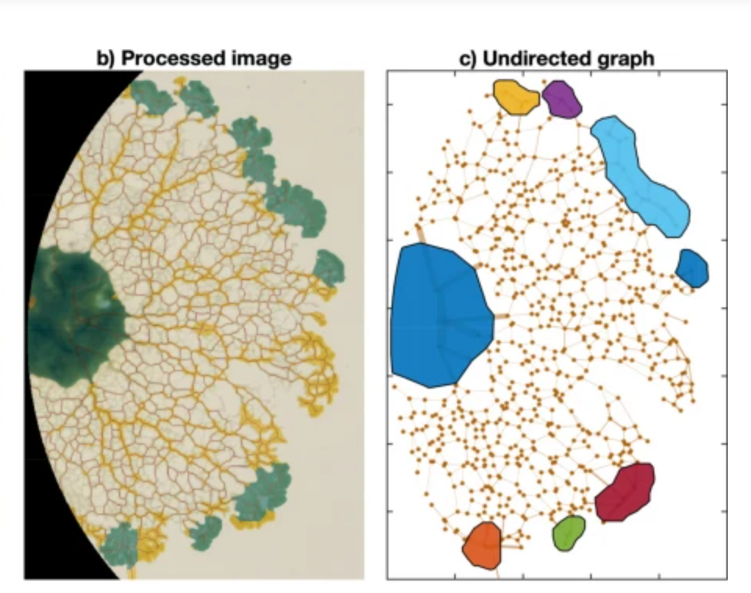
Quantification Code
In-progress
Analysis of result
Number of nodes
Node density
Average distance between nodes
Histogram of node-node distances
Network Cost
Connectivity
Resiliency
Patino-Ramirez, F., Arson, C. & Dussutour, A. Substrate and cell fusion influence on slime mold network dynamics. Sci Rep 11, 1498 (2021). https://doi.org/10.1038/s41598-020-80320-2

Slide 14
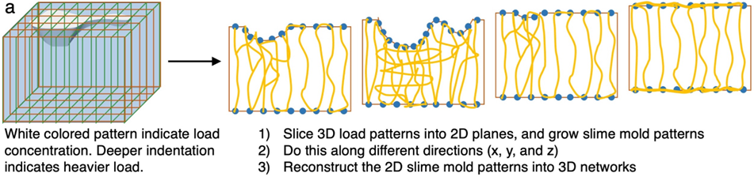
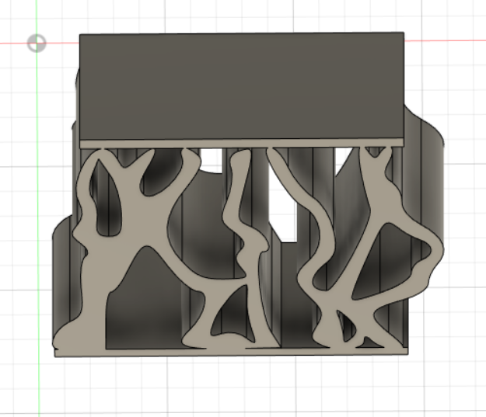
Potential Impact
Creation of stochastic structures that can be manufactured for precise shapes and also precise force directions and magnitudes

Slide 15
Results
Plots displays chemoattractant gradient from a low to high force of attraction for the two scenarios of the growth behaviour
White(indicates low attraction & start to the random Walk)
Yellow/Rose Indicates a medium level of attraction and is getting closer to the nutrient center
Rose- Indicates the highest level of attraction.
Completely Random walk is arbitrary and does not populate to the nutrient center.
Biased starts off in a pattern/sequence taking a relatively straight pathway to the “target” nutrient center.
-Distance between nodes of biased walk to the nutrient center reveal a “ relative consistency”.

Slide 16
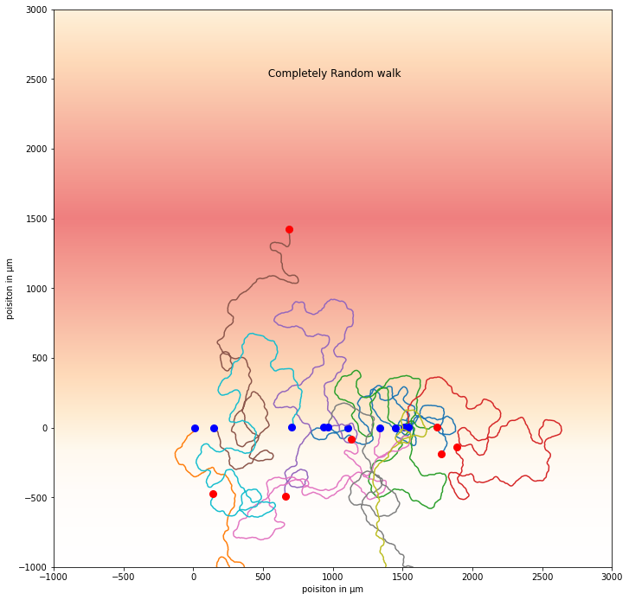
Results - Random walkers using chemoattractant line
Notes:
Parameters used for this: vel =10.0; dt = 1; Drot = 0.05; Dtrans = 5; nutrient_conc = 10^5, start_conc = 10^3

